Slide 1
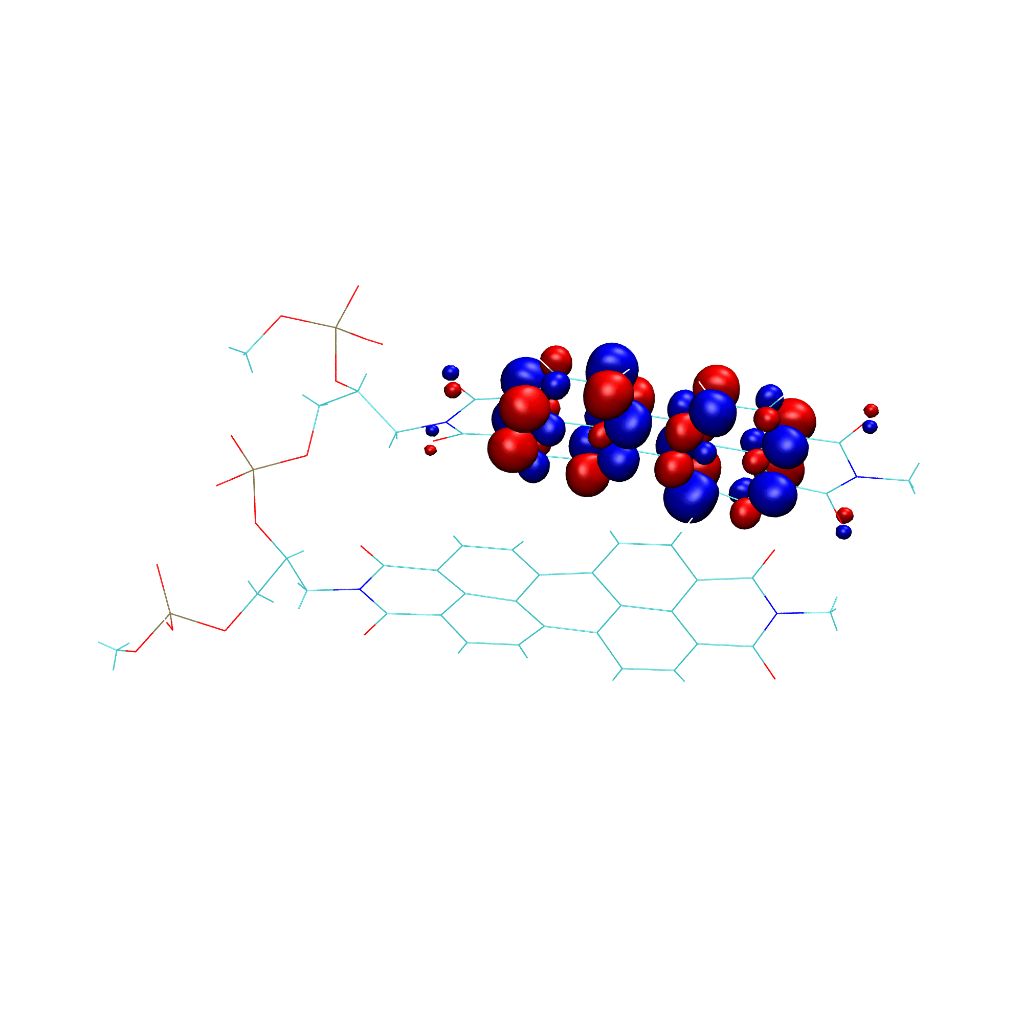



Photoexcitation Dynamics in Perylene Diimides
^{Aliya Mukazhanova}
DMR-1847774

Slide 2
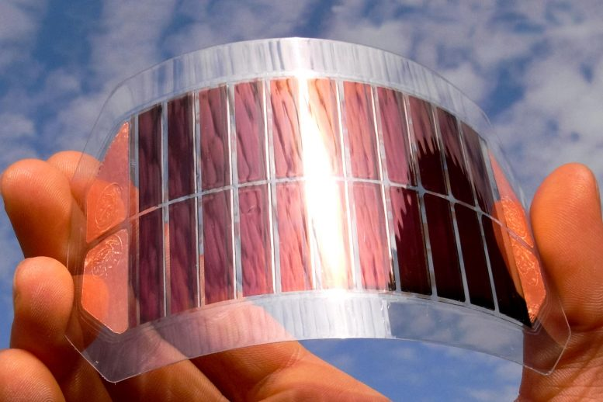
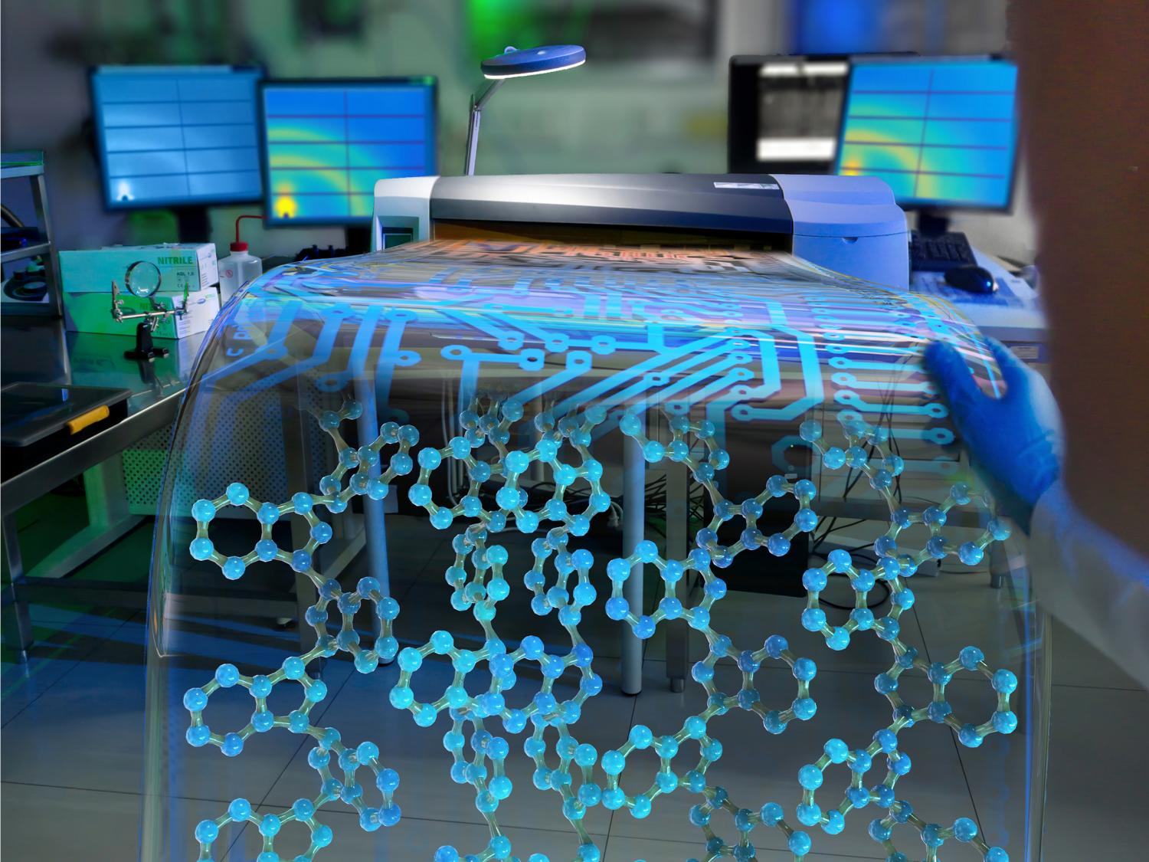
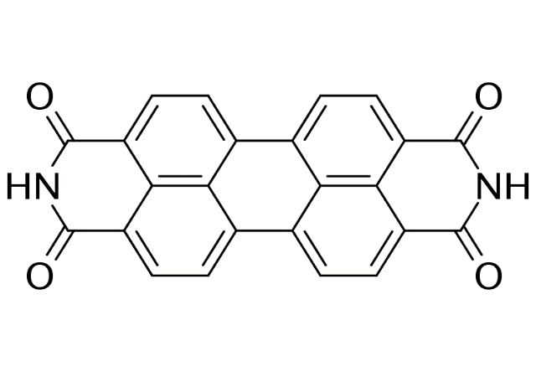
Perylene Diimide
Promising for organic optoelectronics and light harvesting
Controllable electronic characteristics
Outstanding chemical, thermal and photostability
High electron conductivity, strong light absorption
Affinity to self-assemble
https://scitechdaily.com/new-flexible-ultrathin-organic-solar-cell-is-both-highly-efficient-and-durable/
https://phys.org/news/2015-06-optimized-enables-custom-electronics.html
Perylene-3,4,9,10-tetracarboxylic diimide
(PTCDI)

Slide 3
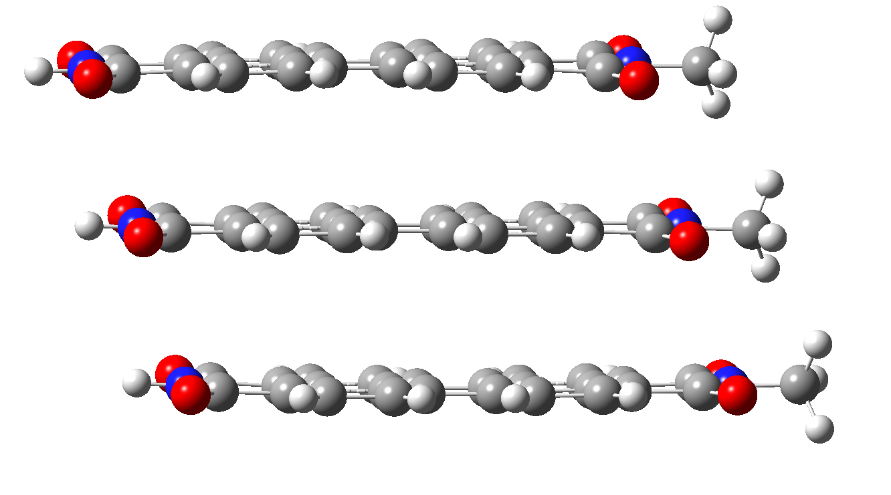
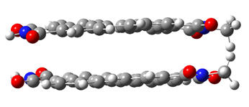
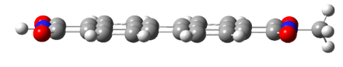
Perylene Diimide
Transport optical excitation energy efficiently¹⁻³
The excited-state lifetime and decay pathway are highly dependent on inter-molecular orientation⁴⁻⁷
This work: How inter-molecular interactions influence energy transfer and exciton localization dynamics? What vibrational modes assist the electronic relaxation?
https://scitechdaily.com/new-flexible-ultrathin-organic-solar-cell-is-both-highly-efficient-and-durable/
https://phys.org/news/2015-06-optimized-enables-custom-electronics.html
monomer
dimer
trimer
1. Mazaheripour, A. et al. Mater. Horizons 2017, 4 (3), 437–441
2. Schubert, A. Et al. J. Phys. Chem. A 2014, 118 (8), 1403–1412
3. Ma, L. et al. J. Phys. Chem. A 2014, 118 (5), 838–843 (11)
4. Brown, K. E. et al. J. Phys. Chem. Lett. 2014, 5 (15), 2588–2593.
5. Farag, M. H. et al. J. Phys. Chem. C 2018, 122 (45), 25753–25763.
6. Le, A. et al. J. Am. Chem. Soc. 2018, 140 (2), 814–826.
7. Wirsing, S. et al.J. Phys. Chem. C 2019.

Slide 4
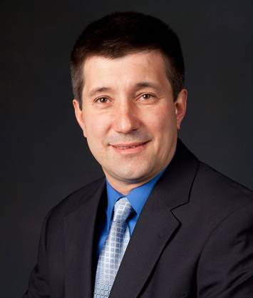

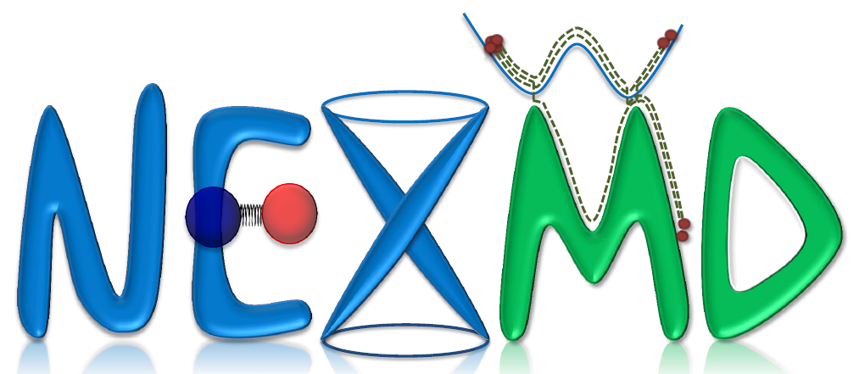
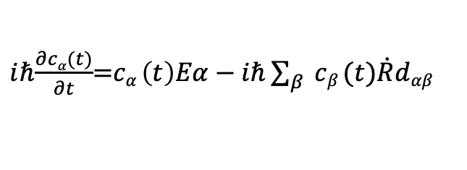
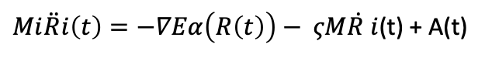
Non-adiabatic Excited State Dynamics
Ground state geometry
Optimized with wB97-XD functional in Gaussian16 code
With Sergei Tretiak (LANL)
Sebastian Fernandez-Alberti (The National University of Quilmes)
Ground state wavepacket
Classical molecular dynamics
run for 300 ps
S2
S1
Excited-State Spectrum
AM1 Hamiltonian
700 trajectories
Non-adiabatic excited state dynamics
Tully’s fewest switches surface hopping 1 ps trajectory
S0
$Mi\ddot{R}i\left(t\right)=−∇Eα\left(R\left(t\right)\right)− ςM\dot{R }i$(t) + A(t)
$i$ℏ$\frac{∂cα(t)}{∂t}$=$cα \left(t\right)Eα−i\text{ℏ}\sum_{β}{ cβ (t)\dot{R}dαβ}$
∆
R
Langevin equation of motion for nuclei
Time-dependent expansion coefficients
T. Nelson, S. Fernandez-alberti, V. Chernyak, A. E. Roitberg and S. Tretiak J. Phys. Chem. B, 2011, 115, 5402; T. Nelson, S. Fernandez-Alberti, A. E. Roitberg and S. Tretiak Acc. Chem. Res., 2014, 47, 1155; J. C. Tully J. Chem Phys., 1990, 93, 1061.

Slide 5
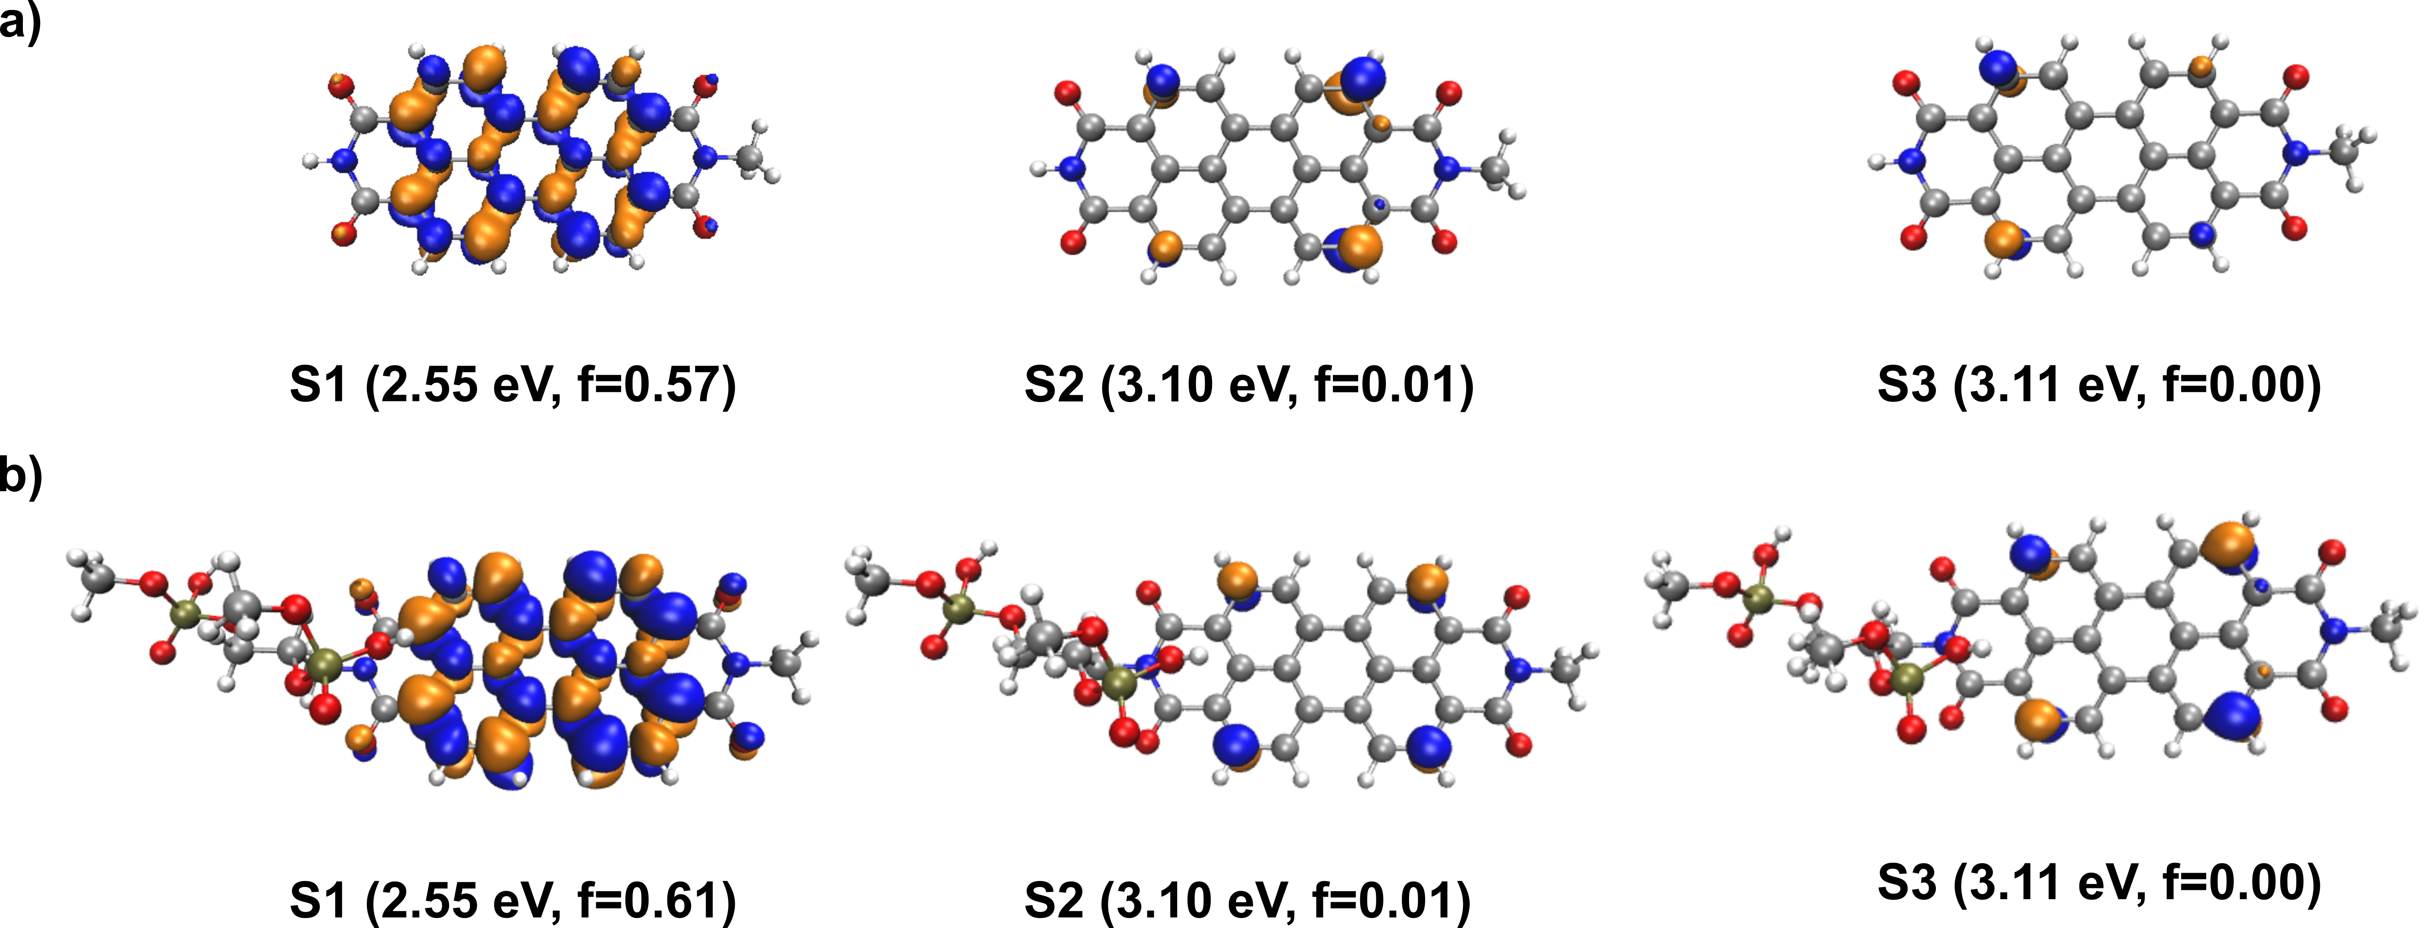
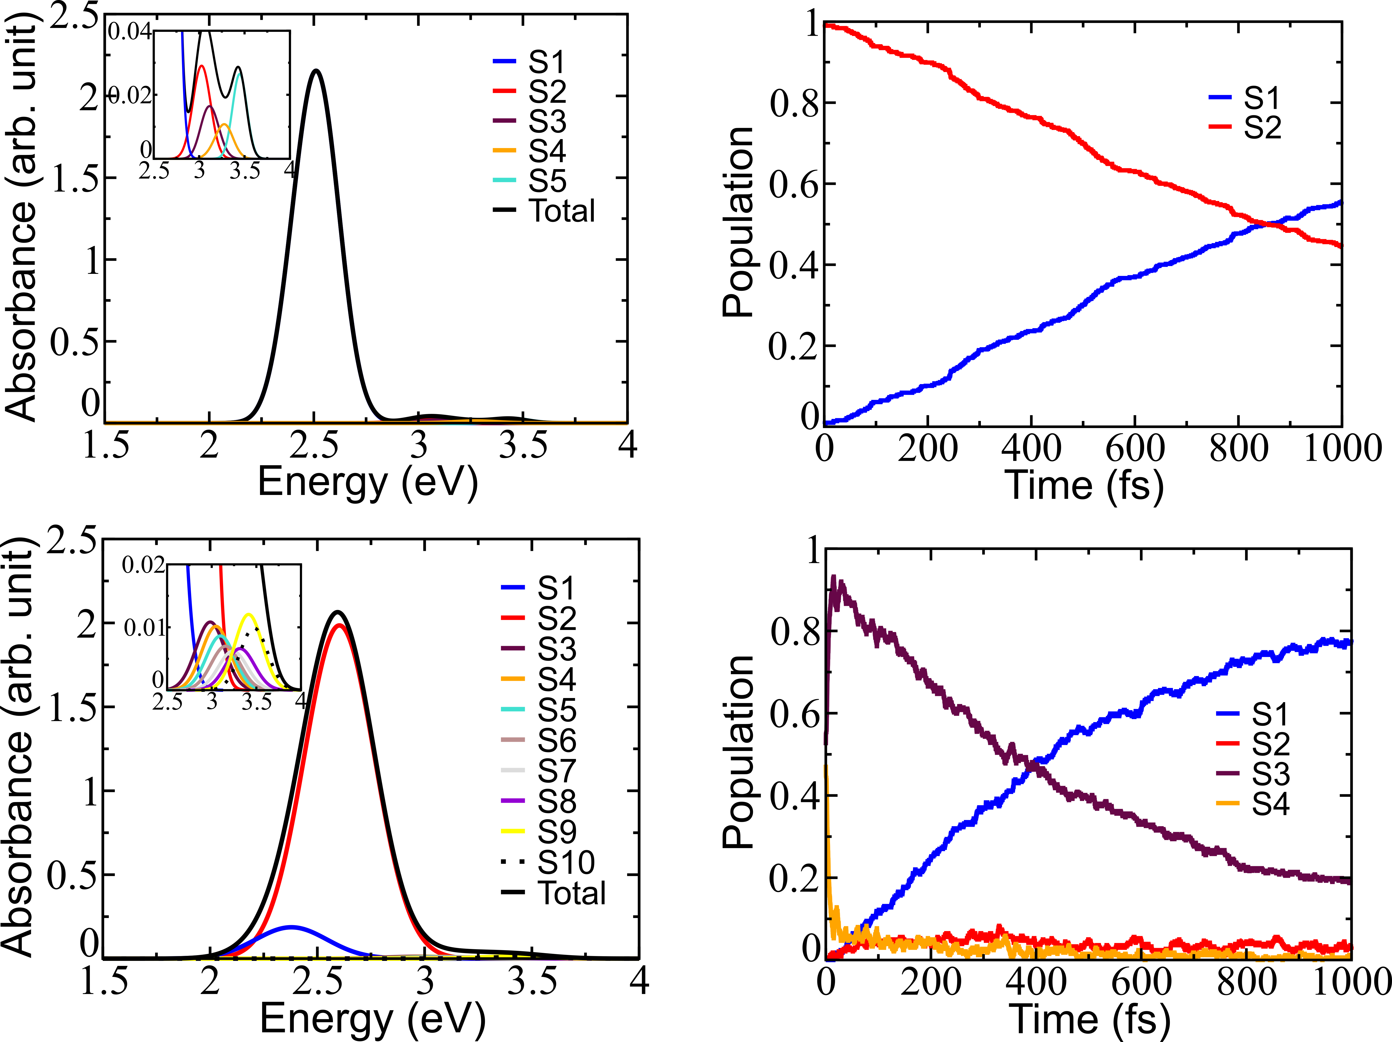
Monomer Internal Conversion Dynamics
Excite S2, non-radiative decay to S1 over ~ 1 ps
50% decay to S1 at 860 fs
A. Mukazhanova, W. Malone, H. Negrin-Yuvero, S. Fernandez-Alberti, S. Tretiak, S. Sharifzadeh, JCP (2020)

Slide 6
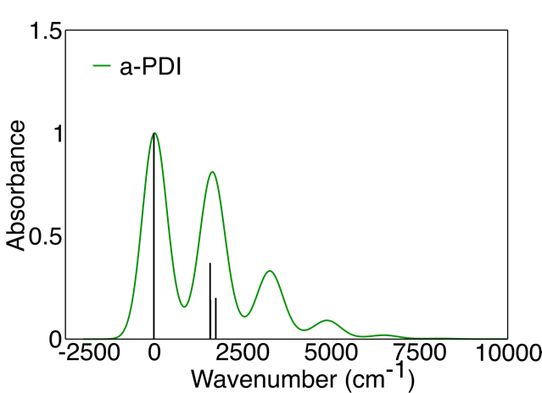
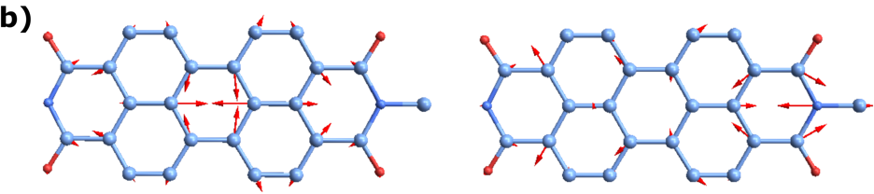
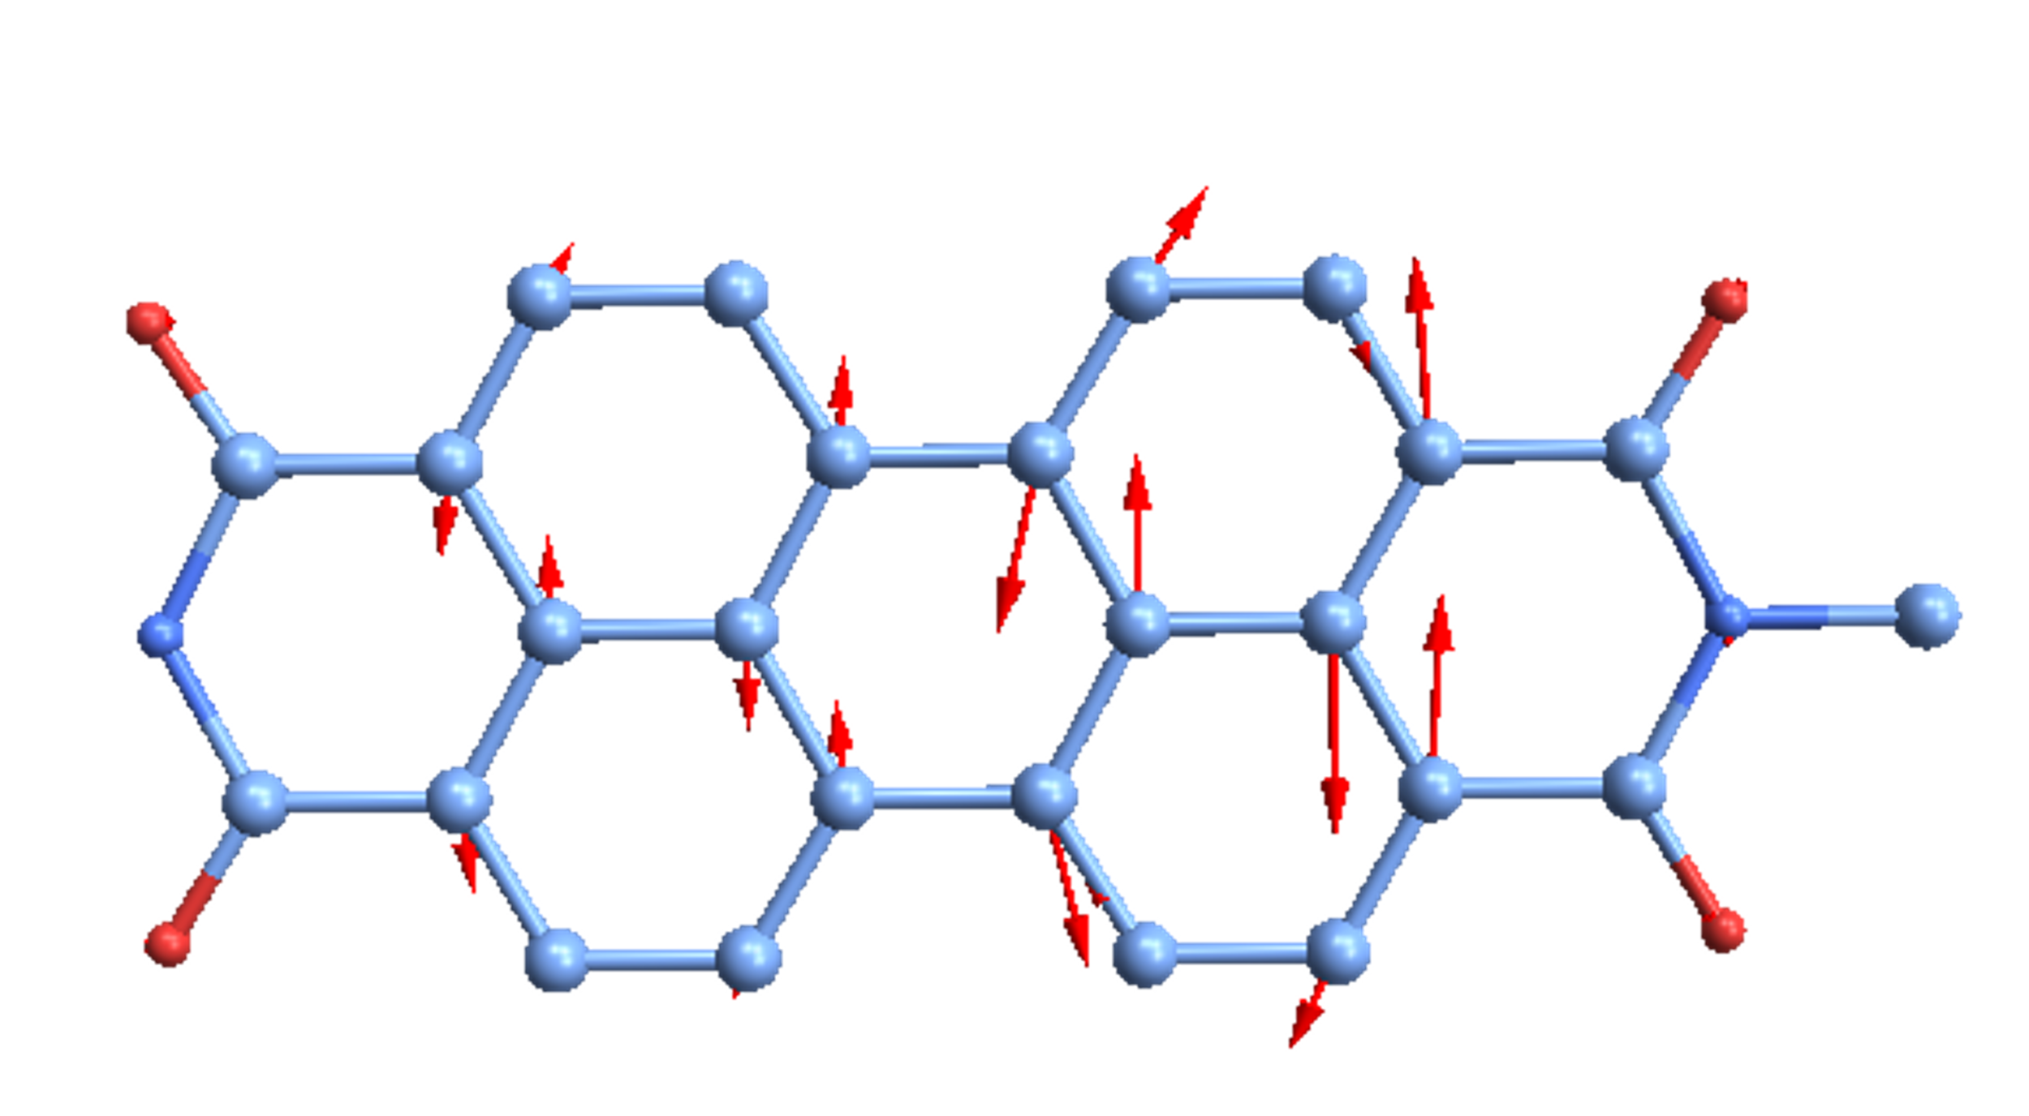
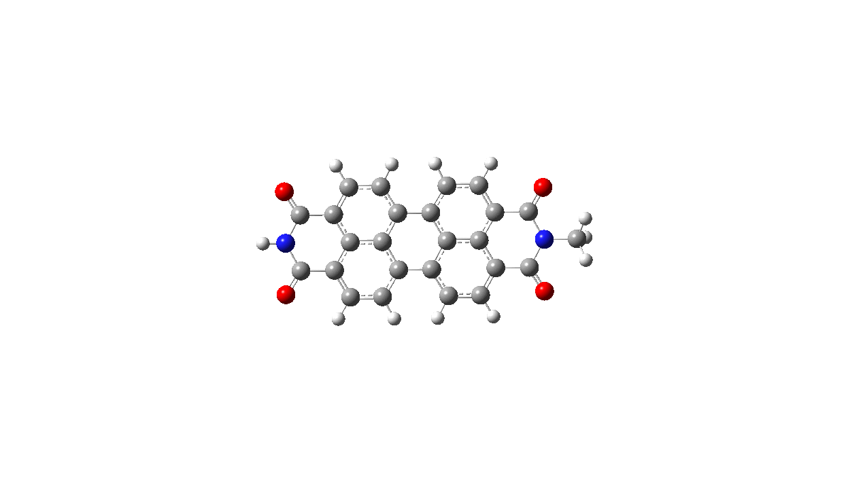
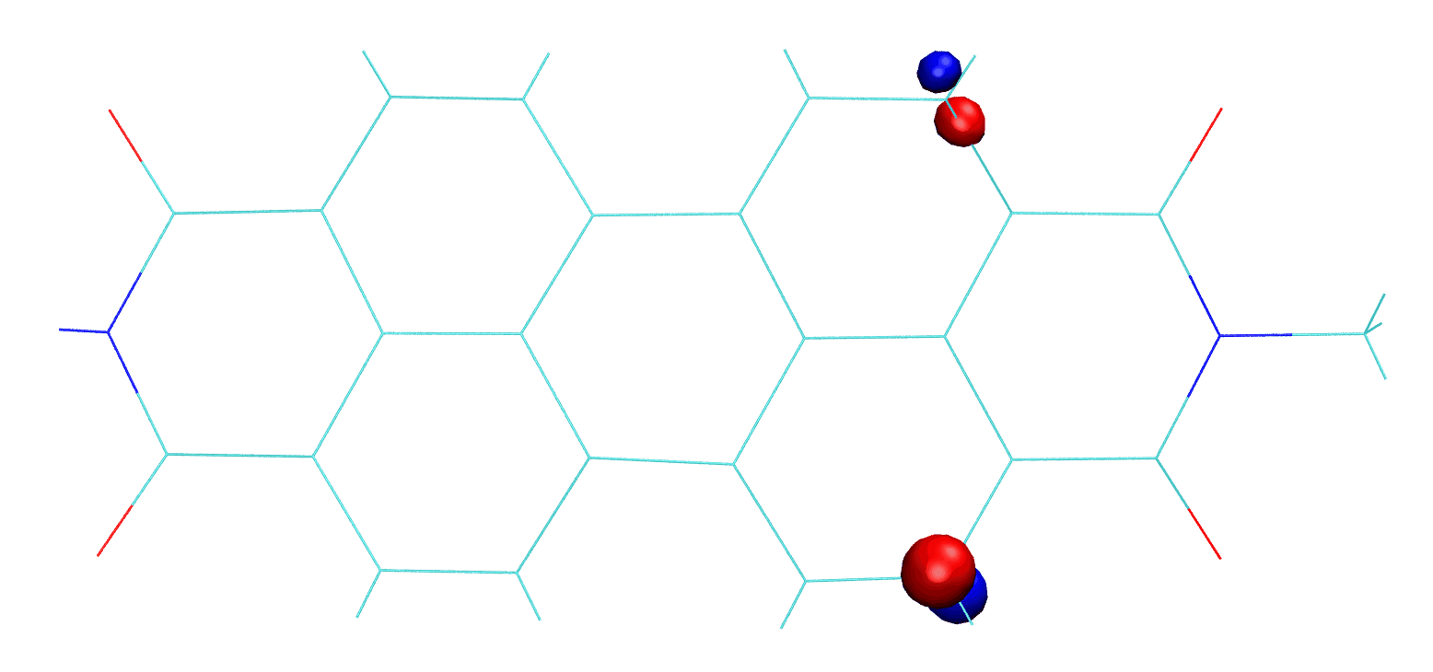
Vibrational Excitations from Franck-Condon analysis : monomer
Franck-Condon spectrum
Mode 101
Mode 102
Mode 113
Atomic motion suggests Franck-Condon active C-C breathing modes important for dynamics
H. Negrin Yuvero, A. Mukazhanova, V. Freixas, S. Tretiak, S. Sharifzadeh, S. Fernandez-Alberti, J. Phys. Chem. A (2022)

Slide 7


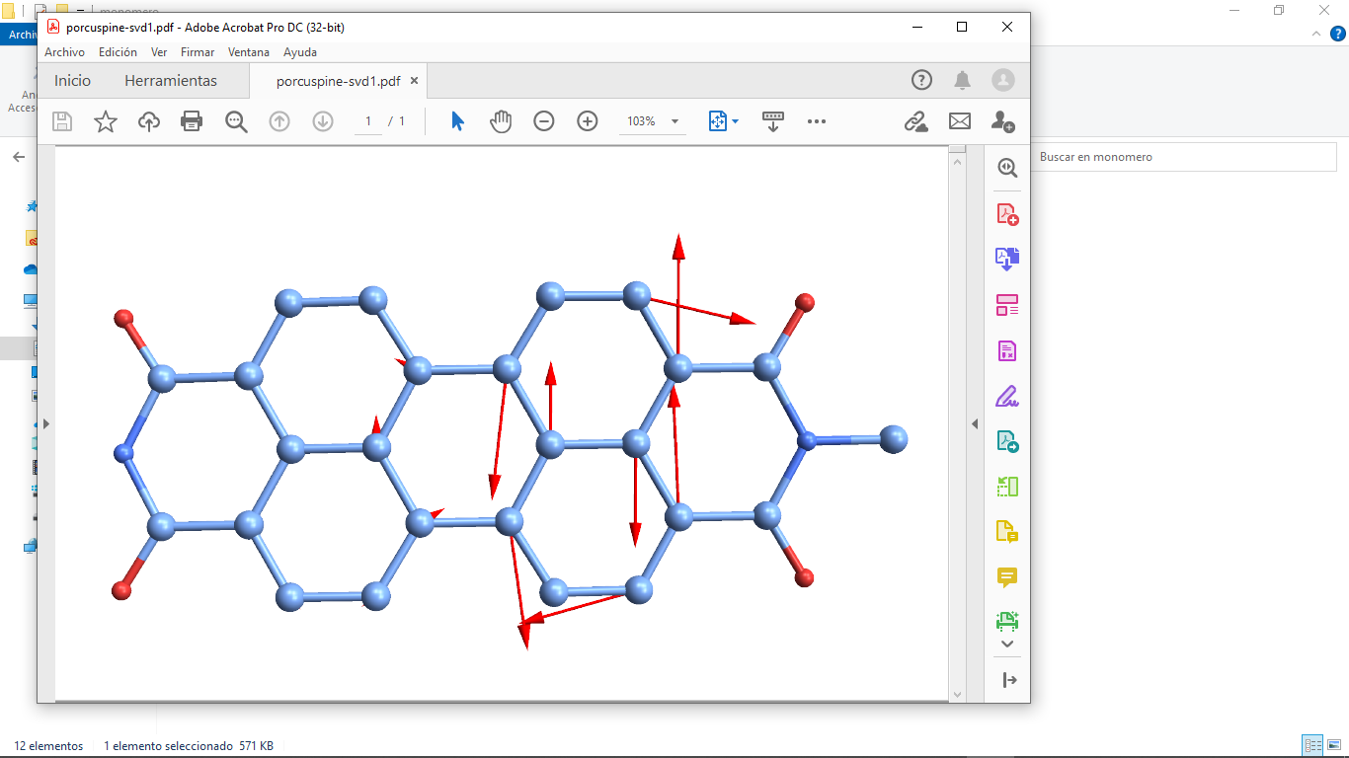
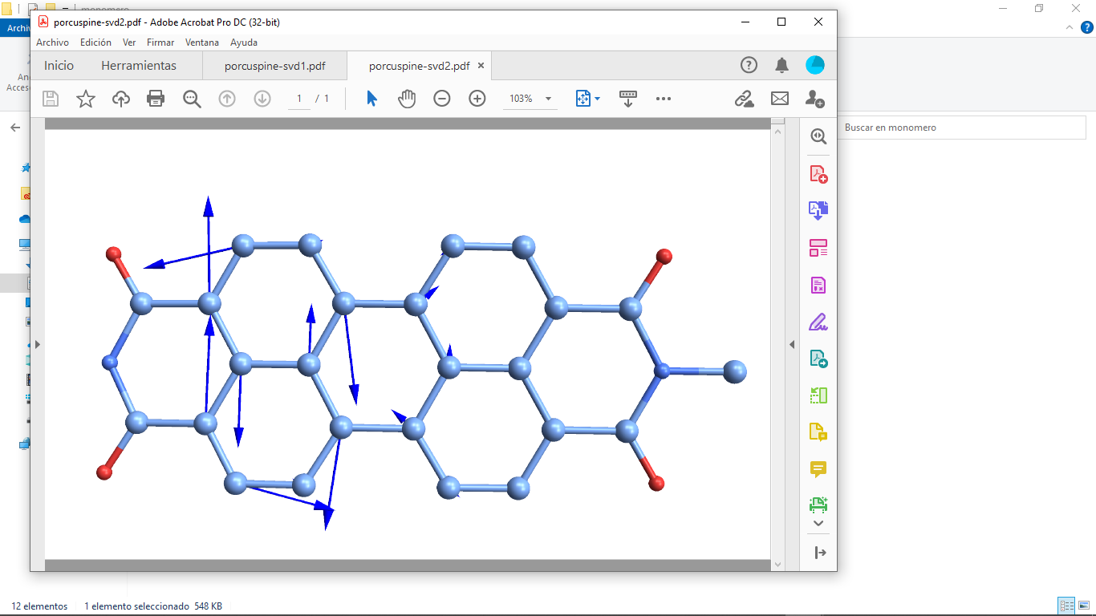
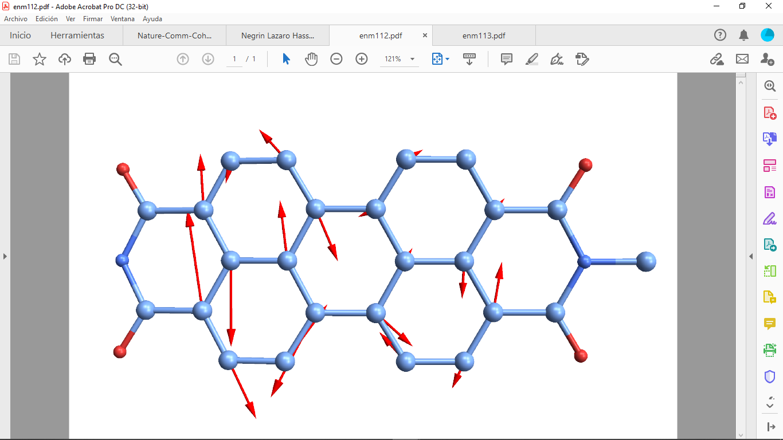
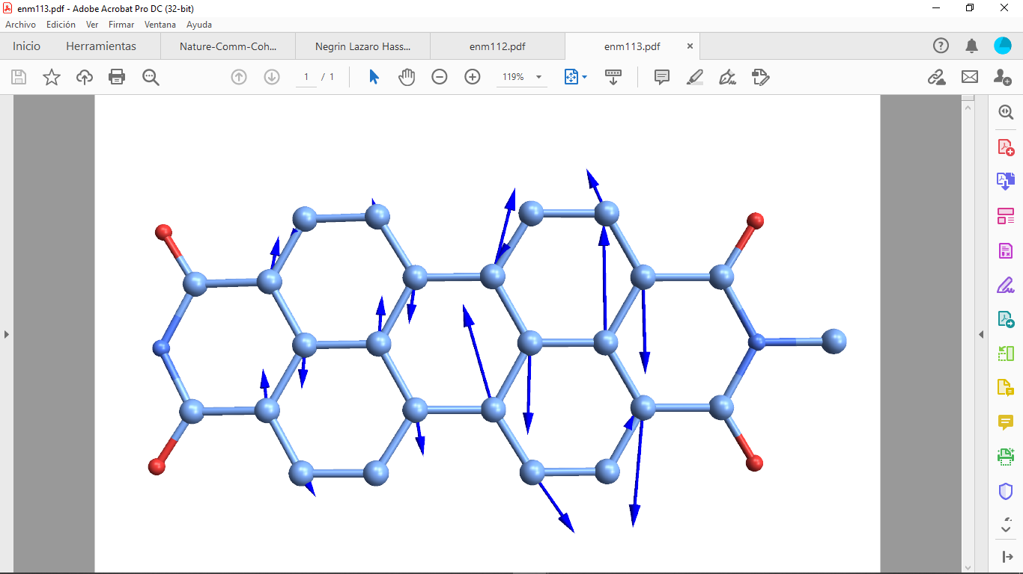



Vibrational Excitations During Dynamics: monomer
Two different vectors of non-adiabatic derivative couplings d₁₂ are identified using the singular value decomposition (SVD)
Victor Frexias
Hassiel Negrin-Yuvero
Mode 101
Mode 102
$$d_{12}^{SVD,1}$$
$$d_{12}^{SVD,2}$$
Mode 113
Franck-Condon active modes
Mode 112
Mode 113
Modes #112 and #113 provide dominant contributions to $d_{12}^{SVD,1}$ and $d_{12}^{SVD,2}$
H. Negrin Yuvero, A. Mukazhanova, V. Freixas, S. Tretiak, S. Sharifzadeh, S. Fernandez-Alberti, J. Phys. Chem. A (2022)

Slide 8
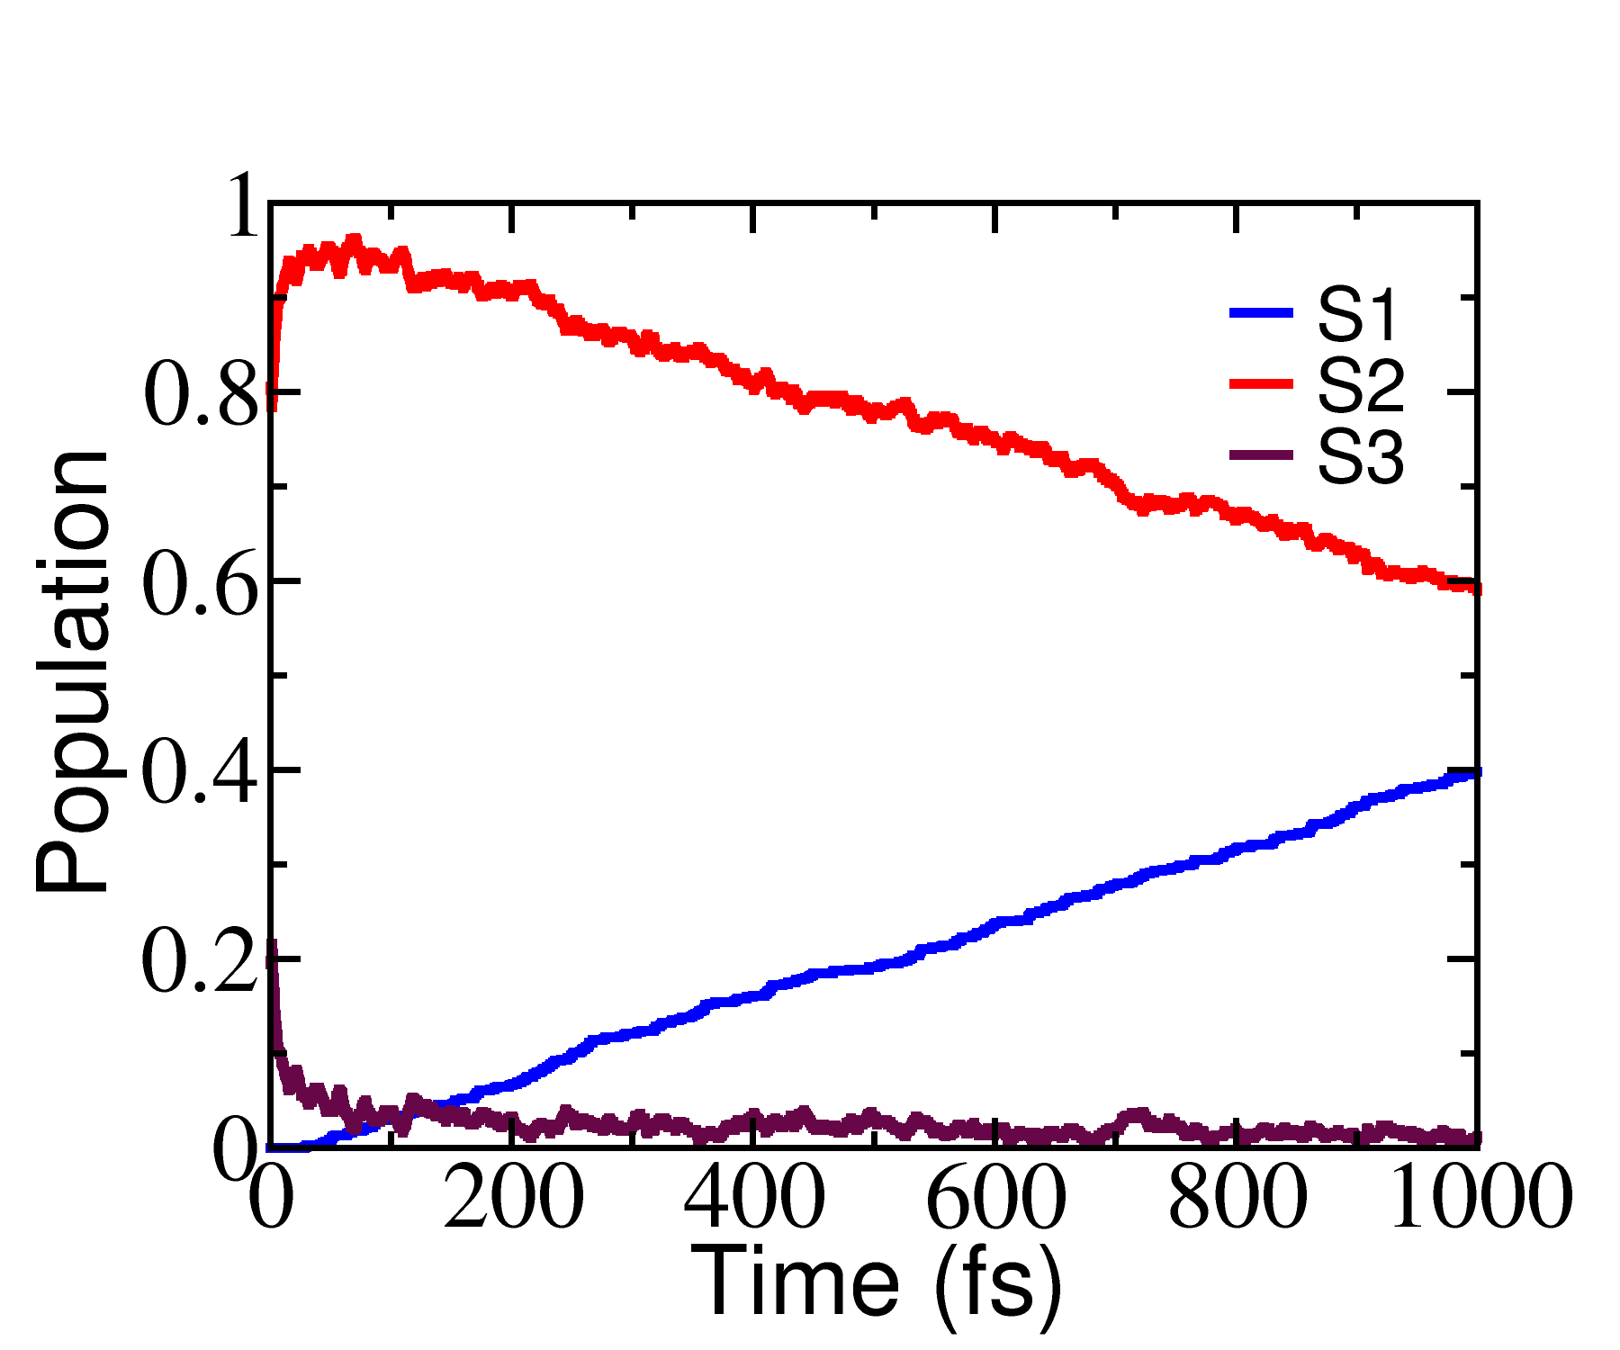
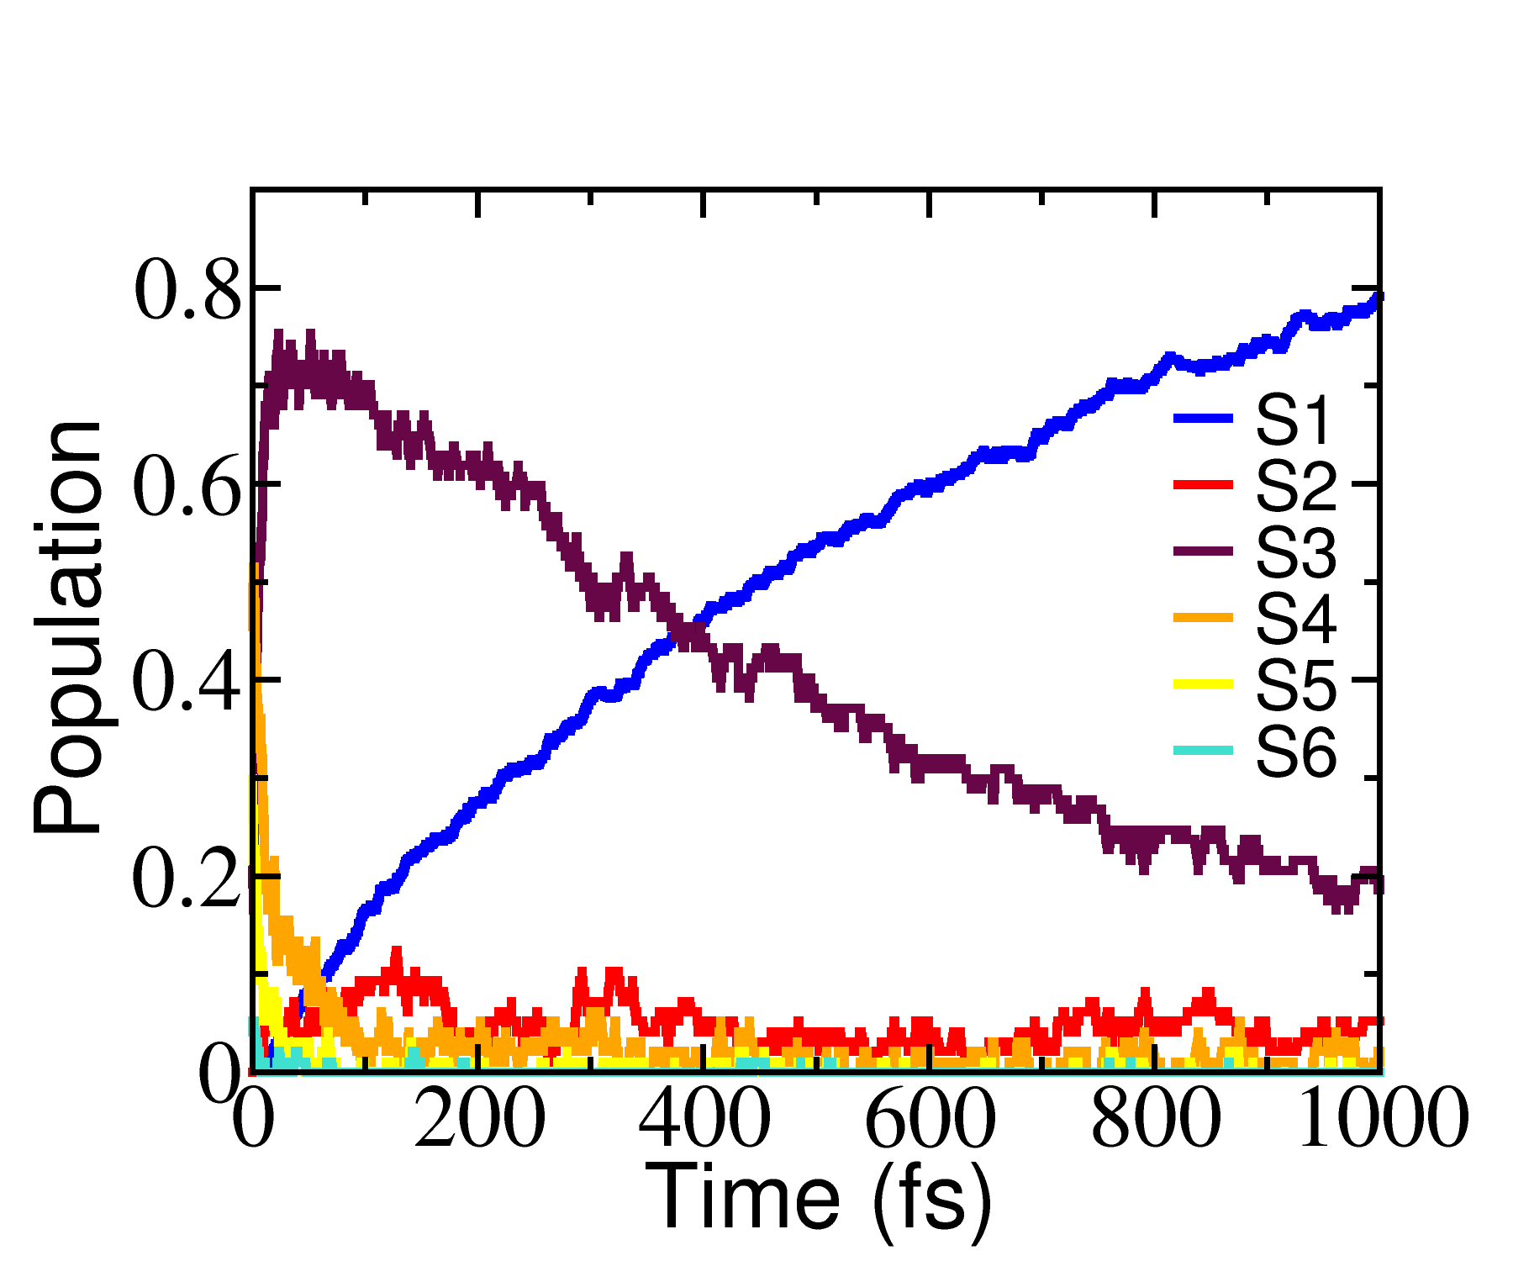
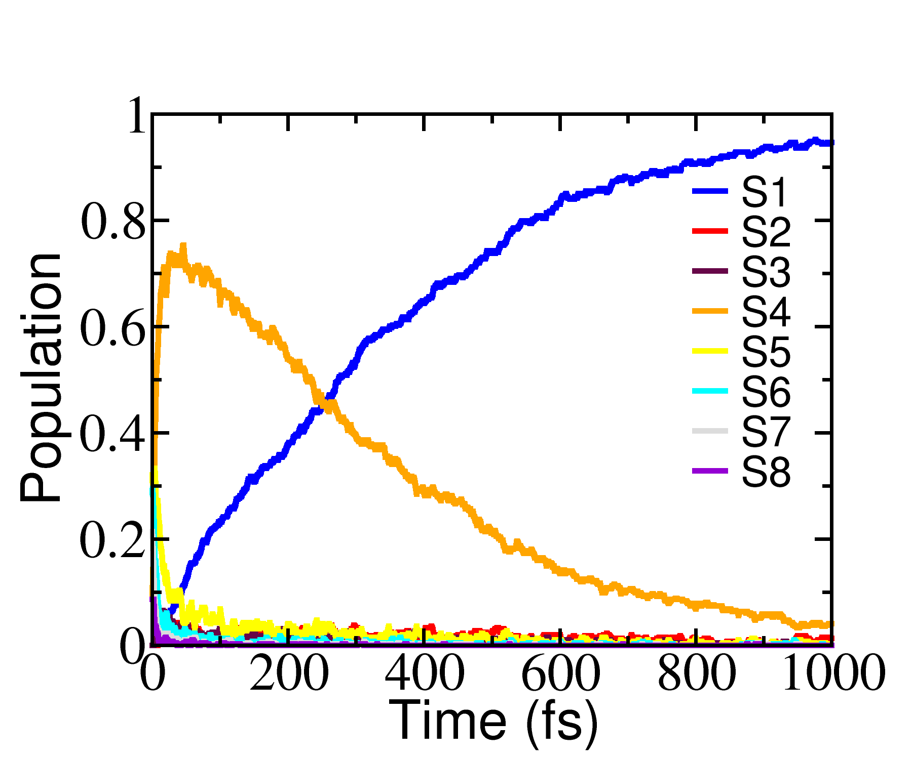
Stacking Leads to Faster Dynamics
Excited at S2
50% decay at > 1 ps
Excited at S4
50% decay to S1 at 400 fs
Excited at S6
50% decay to S1 at 240 fs
S4
S6
S2
S3
S5
0.37
S4
0.38
0.64
S3
0.69
0.52
S2
0.1
0.20
S2
S1
S1
S1
0.12
Reduced energy splitting results in more efficient funneling of energy
A. Mukazhanova, H. Negrin-Yuvero, V. Frexias, S. Fernandez-Alberti, S. Tretiak, S. Sharifzadeh, J. Mater. Chem. C (2023)

Slide 9
Stacking Leads to Faster Dynamics
The analysis of non-adiabatic coupling terms (NACT) explains increase of energy decay in stacked molecules
The internal energy conversion has a sequential character from highest to lower excited state
A. Mukazhanova, H. Negrin-Yuvero, V. Frexias, S. Fernandez-Alberti, S. Tretiak, S. Sharifzadeh, J. Mater. Chem. C (2023)

Slide 10
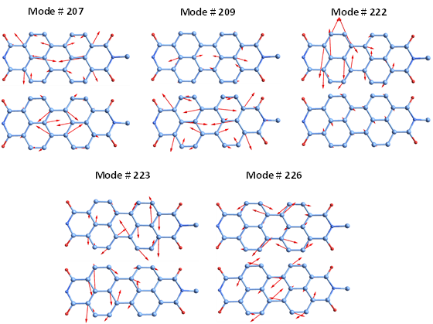
Vibrational Excitations During Dynamics: dimer
Effective hop |  | Effective hop
S₃→S₂ |  | S₂→S₁
# Mode | Overlap | # Mode | Overlap
226(1865) | 0.78 | 226(1865) | 0.88
209(1693) | 0.27 | 223(1795) | 0.16
207(1679) | 0.25 | 222(1792) | 0.16
222(1792) | 0.14 | 207(1679) | 0.14
199(1596) | 0.13 | 225(1797) | 0.12
223(1795) | 0.13 | 122(908) | 0.10
122(908) | 0.11 | 121(904) | 0.10
175(1416) | 0.10 | 209(1693) | 0.10
121(904) | 0.10 | 224(1795) | 0.09
234(2025) | 0.09 | 234(2025) | 0.08
Victor Frexias
Hassiel Negrin-Yuvero
Similar vibrational modes assists the energy transfer making it more efficient and faster
A. Mukazhanova, H. Negrin-Yuvero, V. Frexias, S. Fernandez-Alberti, S. Tretiak, S. Sharifzadeh, J. Mater. Chem. C (2023)

Slide 11
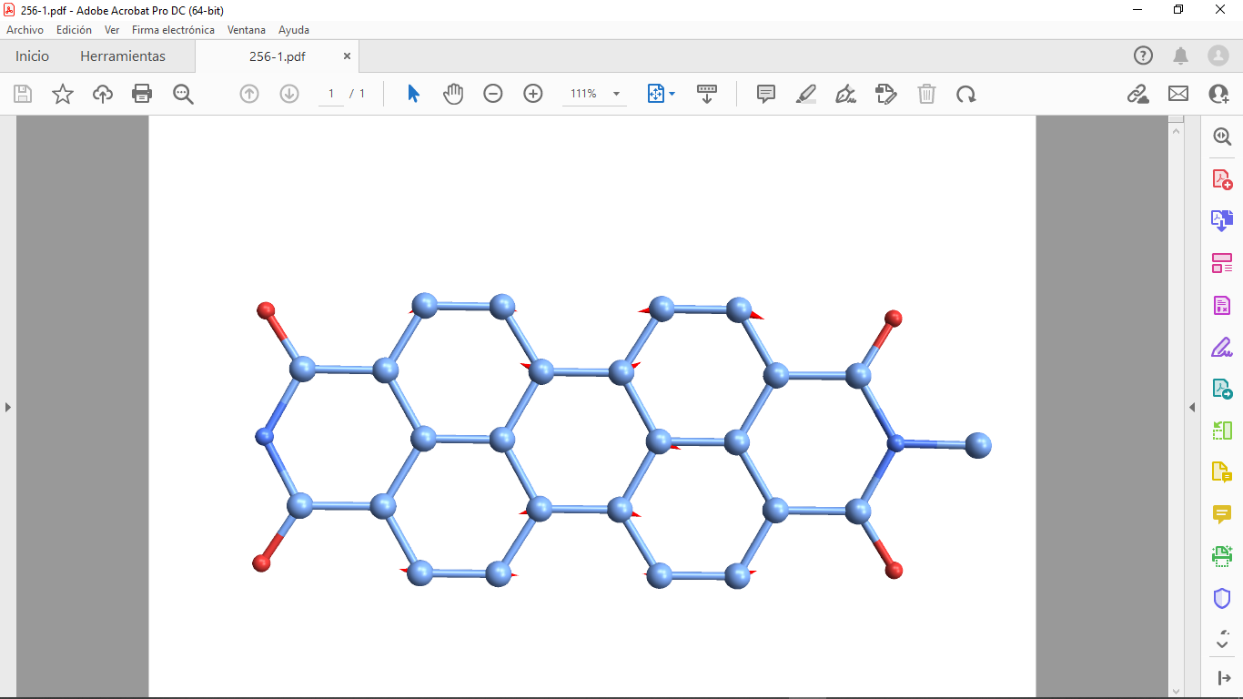
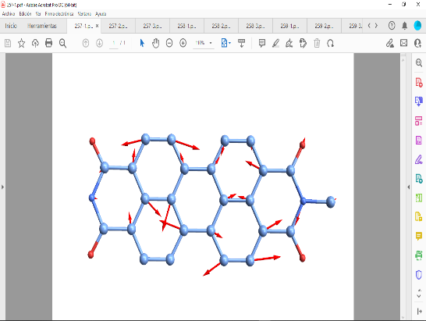
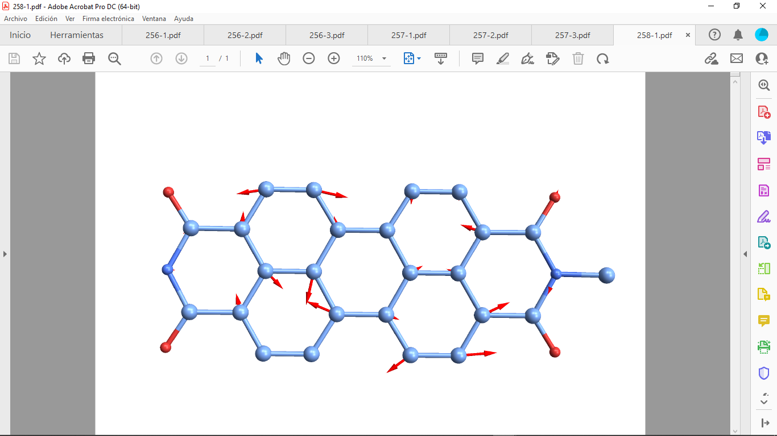
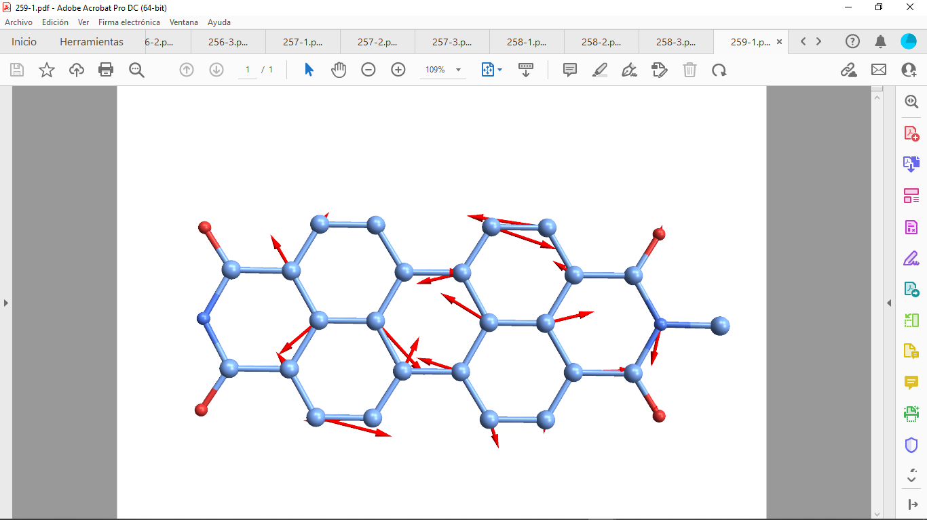
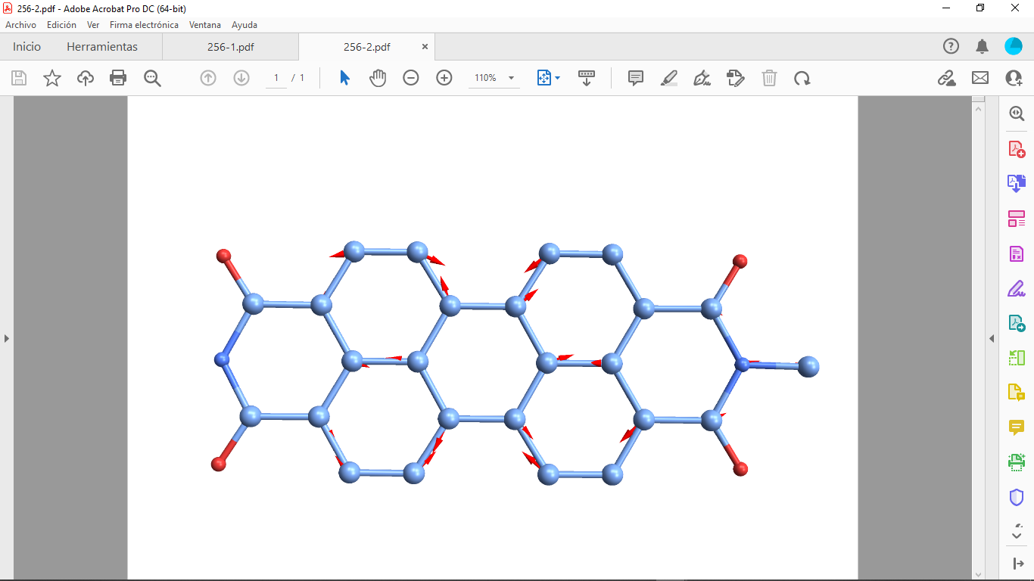
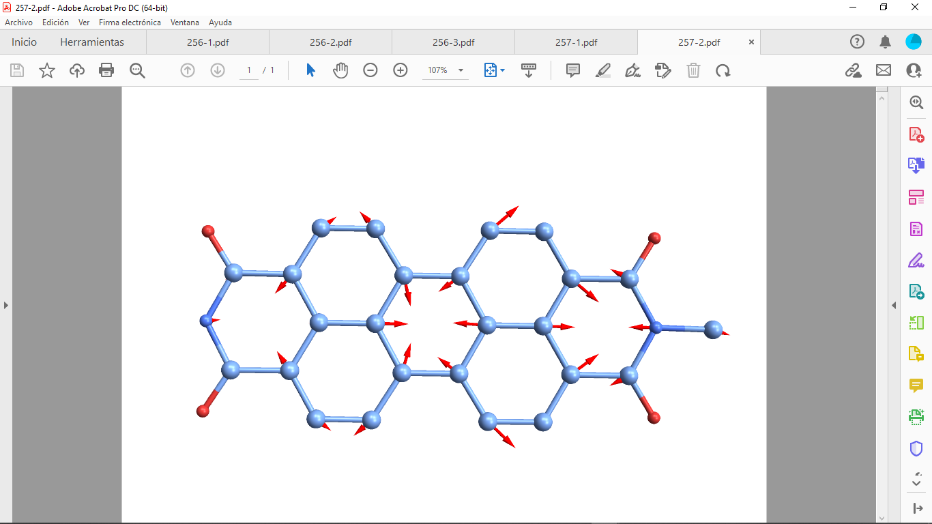
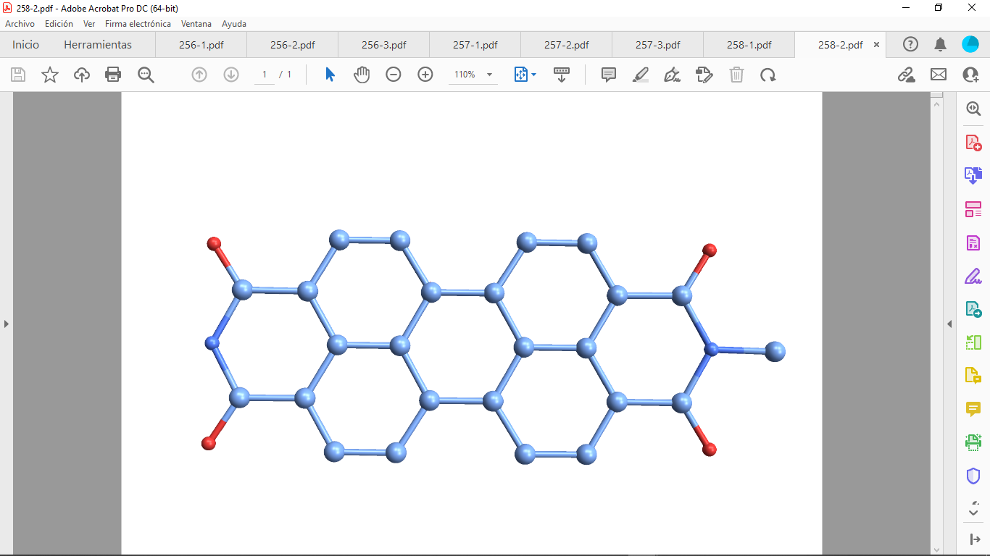
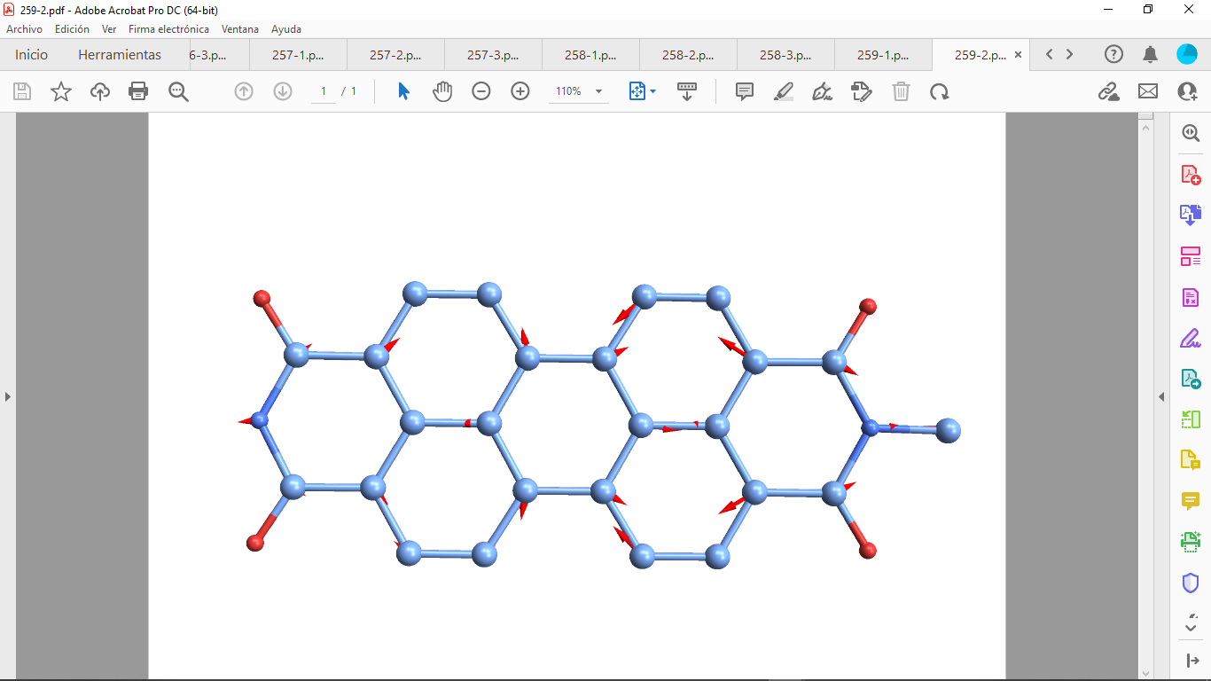
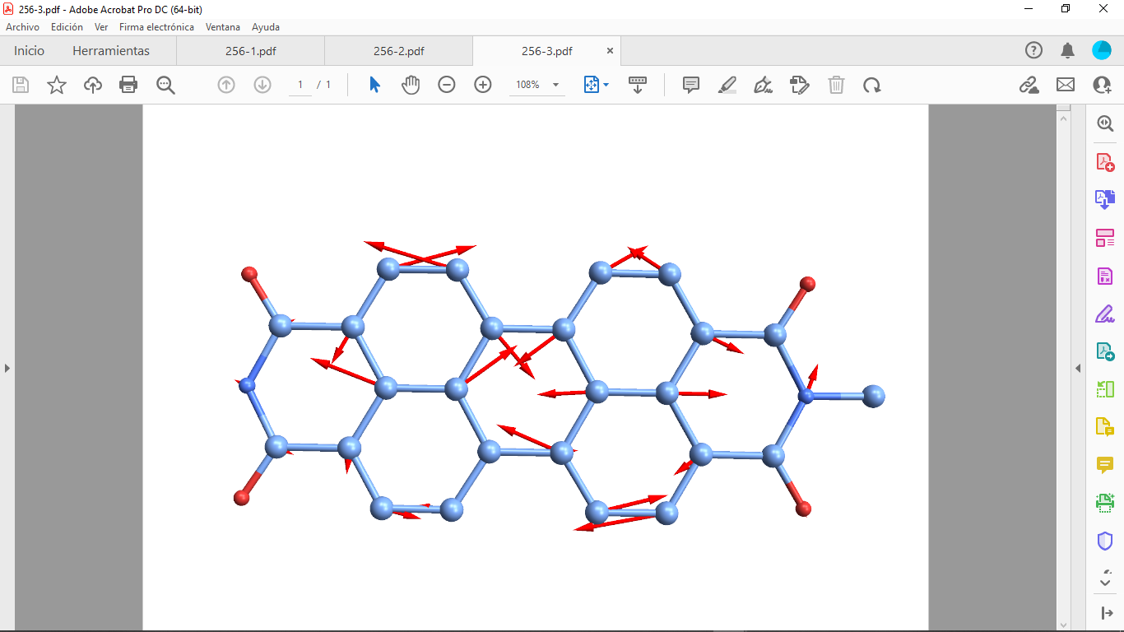
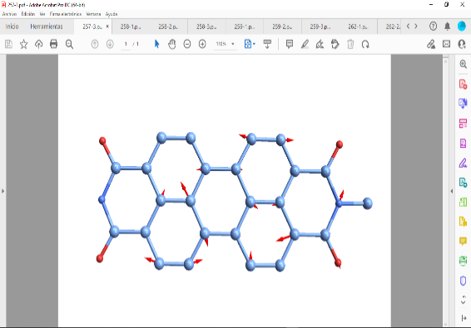
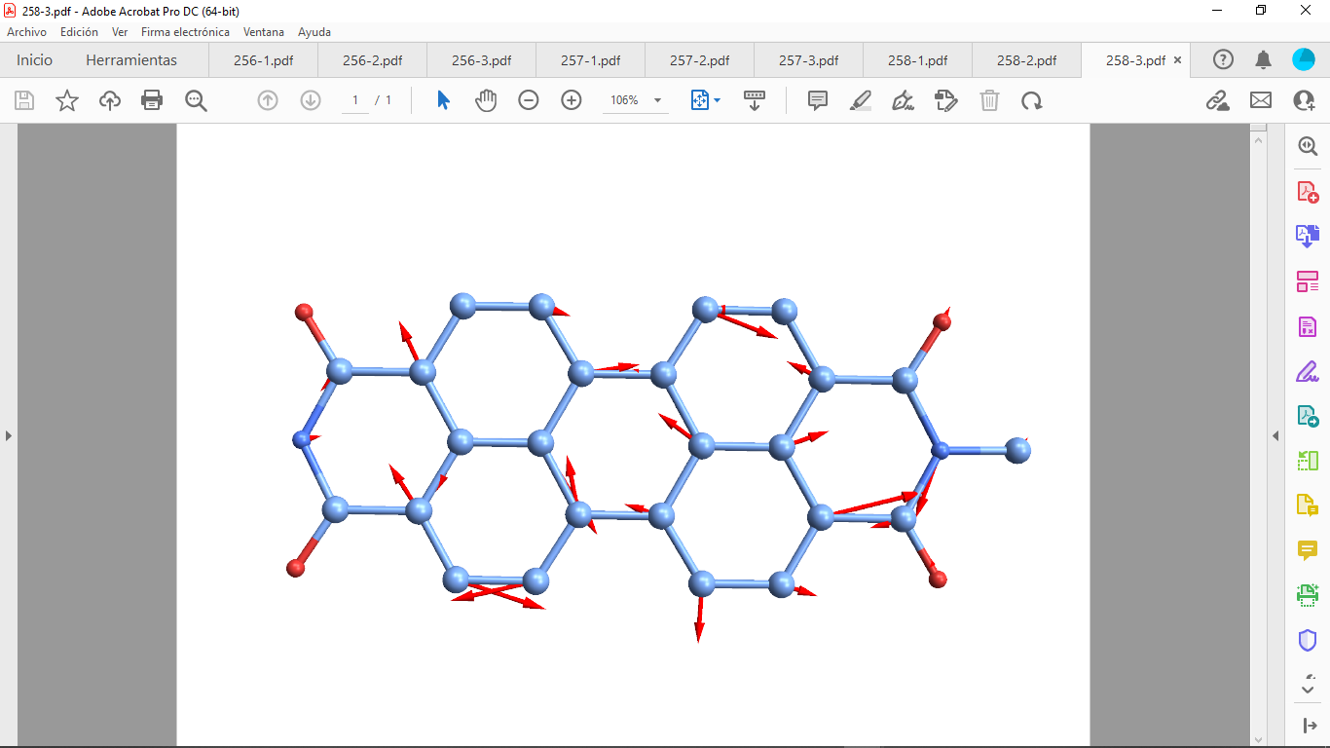

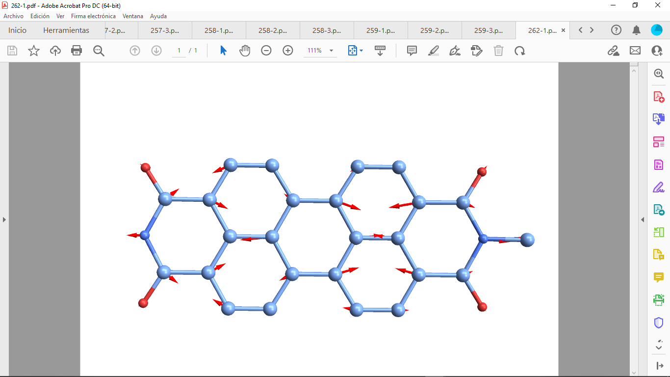
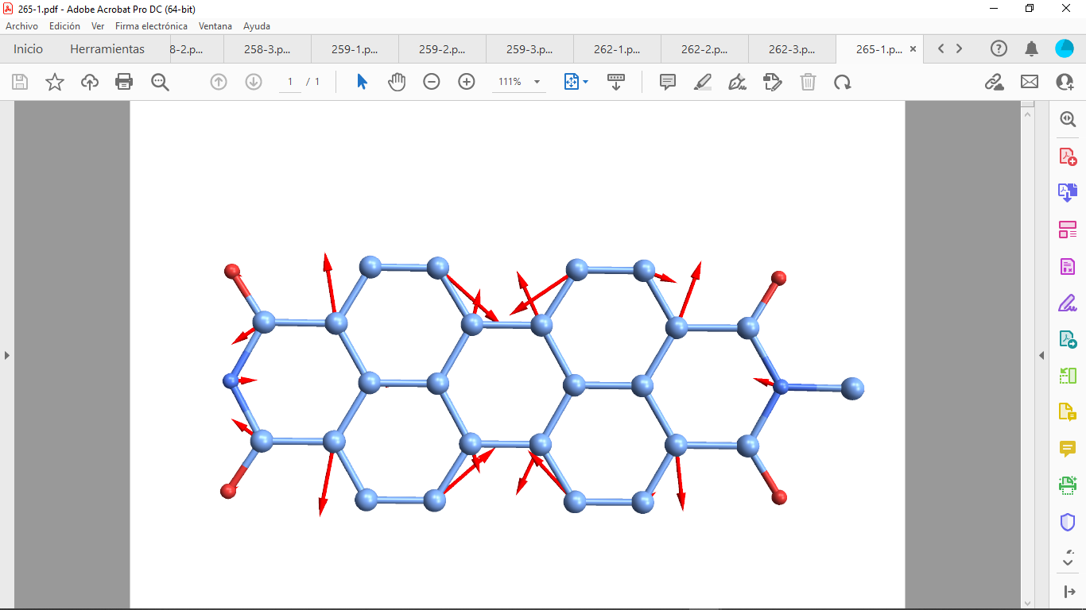

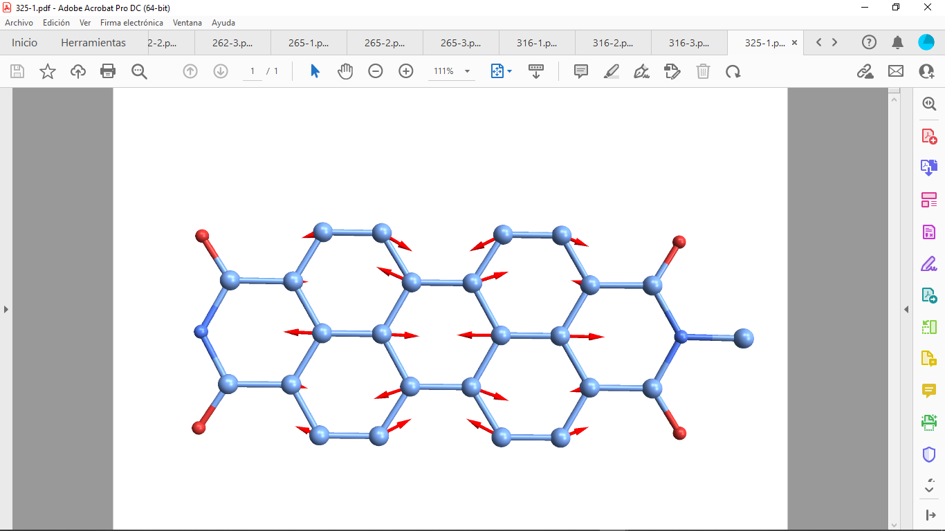
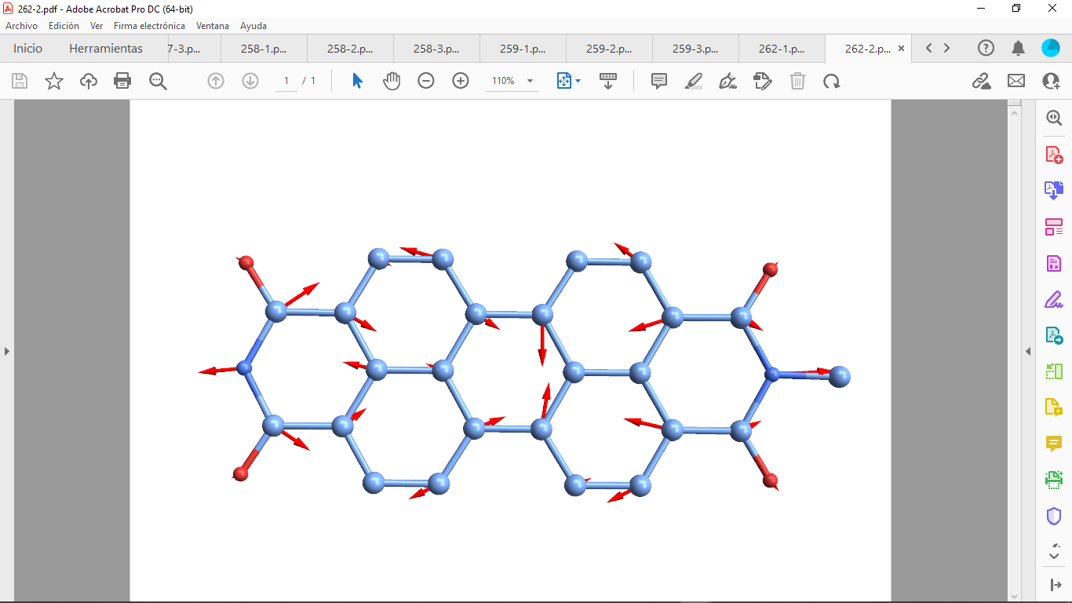


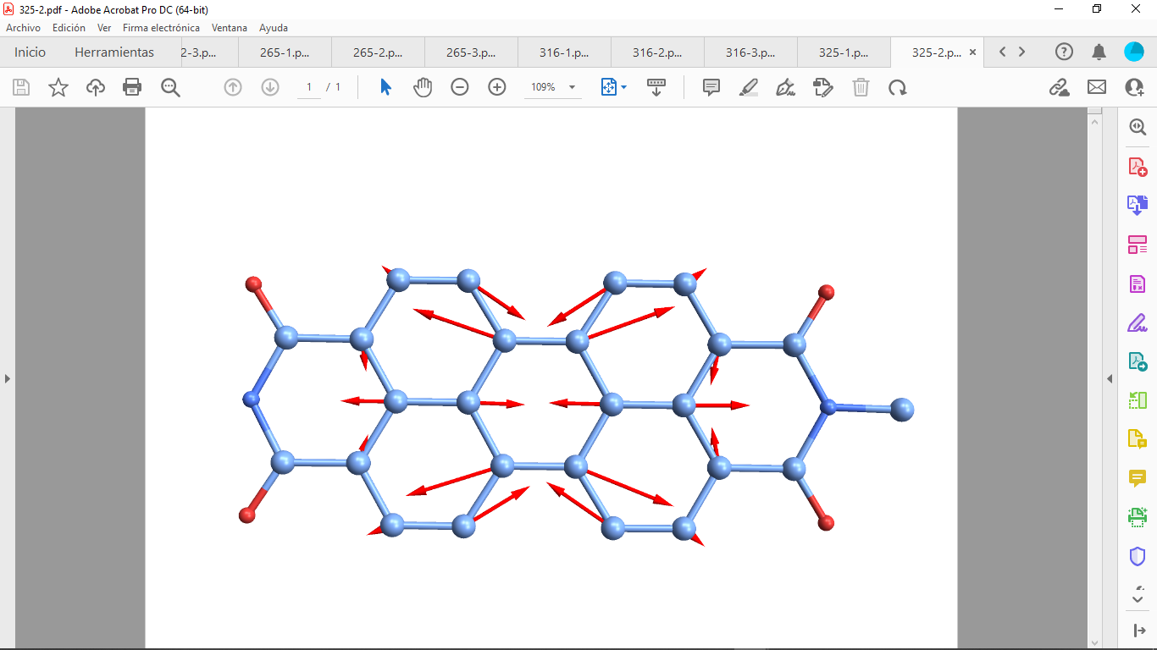

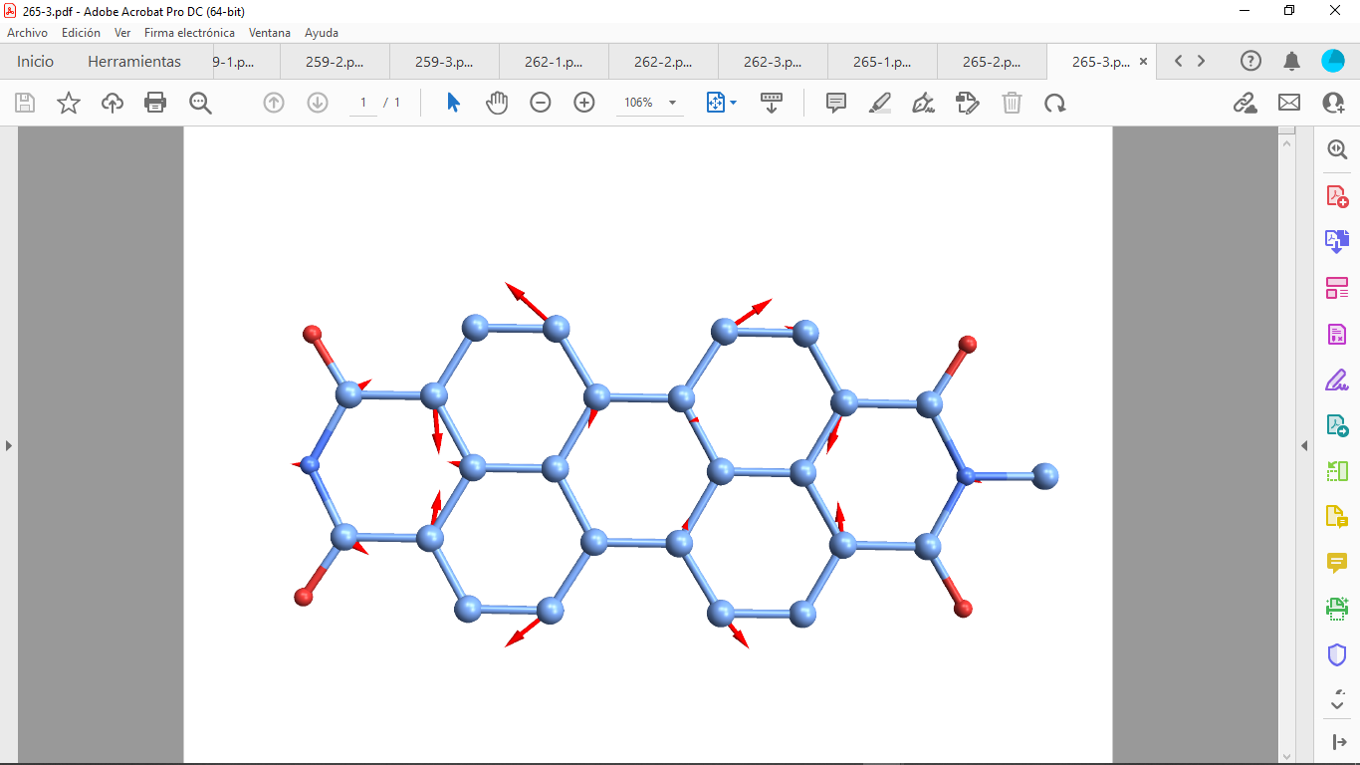
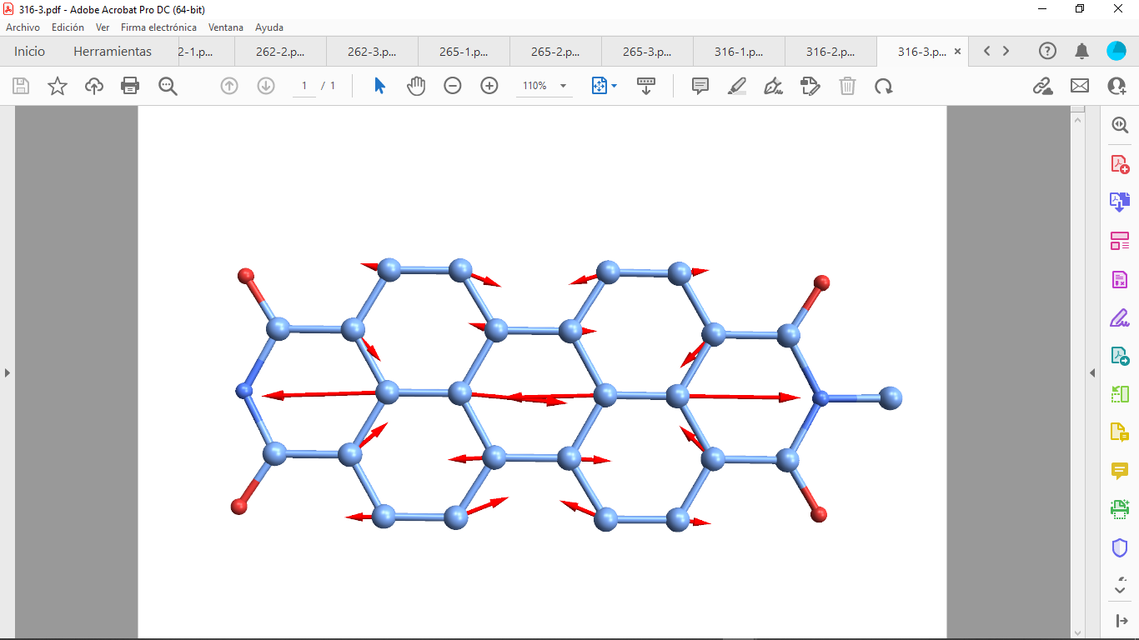
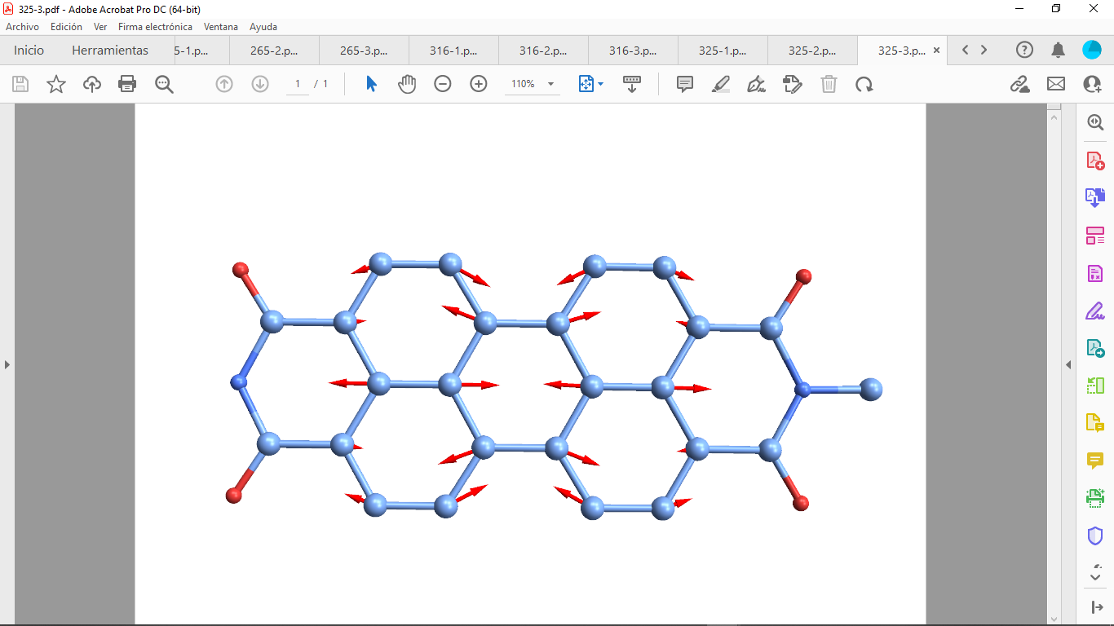
Vibrational Excitations During Dynamics: trimer
Mode # 256
Mode # 257
Mode # 258
Mode # 259
Effective hops
S₄→S₃ |  | S₃→S₂ |  | S₂→S₁
# Mode | Overlap | # Mode | Overlap | # Mode | Overlap
259 (1410) | 0.45 | 256 (1402) | 0.51 | 256 (1402) | 0.53
325 (1763) | 0.38 | 265 (1431) | 0.40 | 265 (1431) | 0.39
257 (1408) | 0.37 | 316 (1719) | 0.37 | 316 (1719) | 0.38
265 (1432) | 0.32 | 259 (1410) | 0.33 | 258 (1408) | 0.31
262 (1419) | 0.25 | 258 (1408) | 0.31 | 259 (1410) | 0.31
264 (1428) | 0.16 | 310 (1647) | 0.18 | 310 (1647) | 0.18
261 (1418) | 0.16 | 274 (1480) | 0.18 | 274 (1480) | 0.17
294 (1580) | 0.15 | 261 (1418) | 0.12 | 271 (1476) | 0.11
286 (1524) | 0.14 | 271 (1476) | 0.11 | 261 (1418) | 0.10
244 (1335) | 0.13 | 287 (1525) | 0.09 | 264 (1428) | 0.10
Mode # 262
Mode # 265
Mode # 316
Mode # 325
Activated vibrational modes are different from dimer case
A. Mukazhanova, H. Negrin-Yuvero, V. Frexias, S. Fernandez-Alberti, S. Tretiak, S. Sharifzadeh, J. Mater. Chem. C (2023)

Slide 12
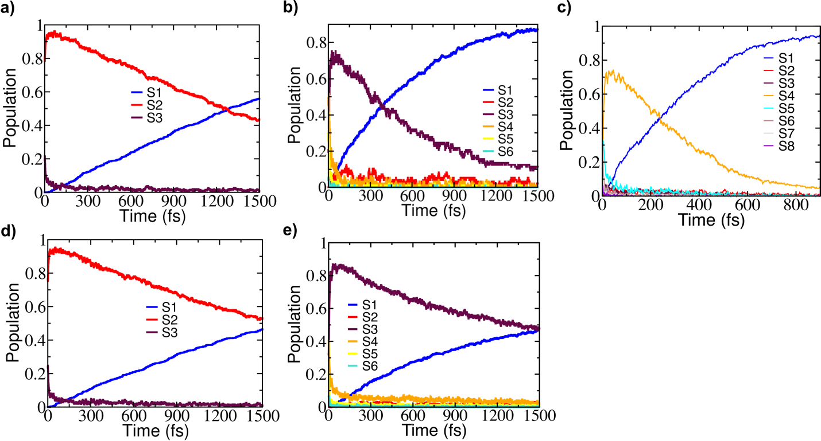
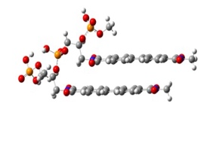
Backbone Slows Internal Energy Conversion Dynamics
Rapid transfers (within a few fs) from higher energy states to S3 and a slower decay from S3 to S1.
There is 50% population transfer from S3 to S1 at 400fs for dimer and at 1500fs for dimer with backbone.
Why backbone slows down the dynamics?
A. Mukazhanova, H. Negrin-Yuvero, V. Frexias, S. Fernandez-Alberti, S. Tretiak, S. Sharifzadeh, J. Mater. Chem. C (2023)

Slide 13
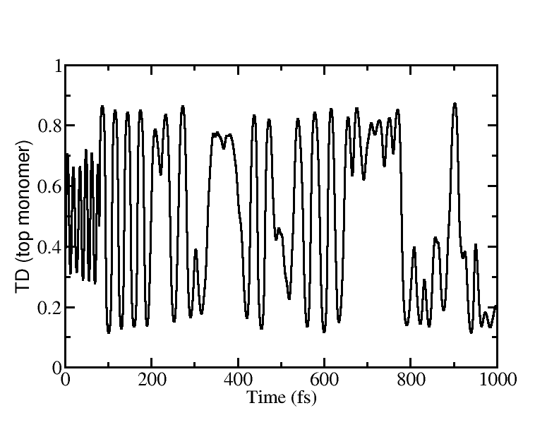
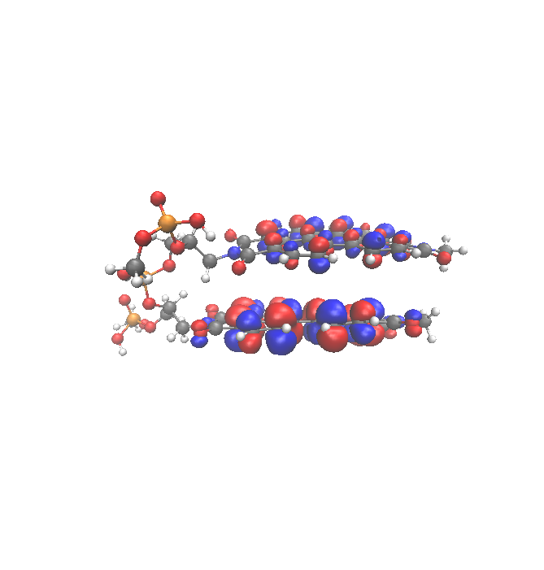
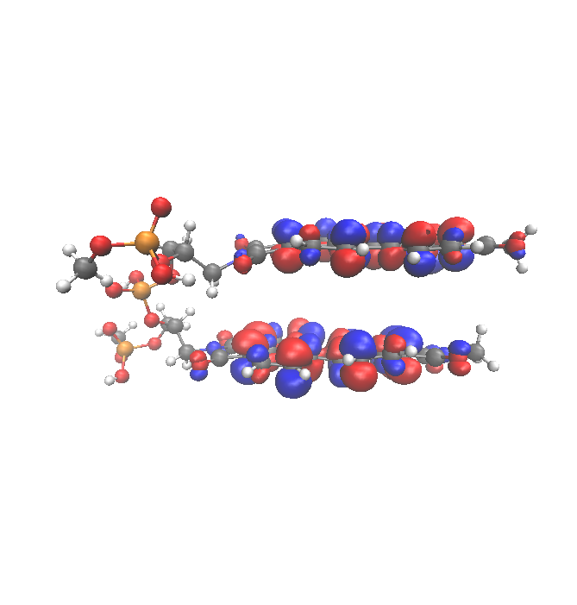


Exciton Localization in Dimer
Example trajectory:
After decay to S1, excited-state localizes and hops between molecules

Slide 14






Exciton Delocalization in Trimer
After decay to S1 (246 fs), excited-state delocalizes

Slide 15

Conclusions
Photo-induced excited-state dynamics of functionalized perylene diimide monomer, dimer and trimer
The stacking accelerates the energy transfer due to reduced effective energy gap and activation of similar vibrational modes
The set of activated vibrational modes are different in dimer than in trimer.
The backbone slows down the relaxation rate
The Sharifzadeh group
Collaborators:
Walter Malone (LANL)
Hassiel Negrin-Yuvero (UNQ)
Victor Frexias (UNQ)
Sebastian Fernandez-Alberti (UNQ)
Sergei Tretiak (LANL)
Funding
DMR-1847774

